Slide 1

Using supervised learning for the Binary classification of Type 2 Diabetes
Data wrangling, preprocessing, exploration and model planning.
Lewis Higgins – 22133848

Slide 2



Dataset overviews - Sources
This project wrangles data from two datasets, both sourced from Kaggle.
The first dataset is a well-reputed dataset containing data on women of Pima Indian (Native American) heritage, originally from the National Institute of Diabetes and Digestive and Kidney Diseases, uploaded by the UCI Machine Learning Repository.
The second dataset is less known, though has been previously used in literature from Zou et al. (2024) and consists of data on female patients from a hospital in Frankfurt.
Notes:
The Pima Indian dataset is not actually from India, but rather of women of Pima Indian heritage in Phoenix, Arizona, USA. (Akmeşe, 2024).
Additionally, Pima Indian refers to a specific Native American heritage and is not related to the country (Chang et al, 2024), hence the American flag.
This is a common misconception in various analyses of this data on Kaggle.

Slide 3
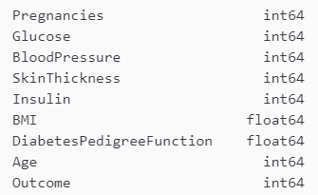
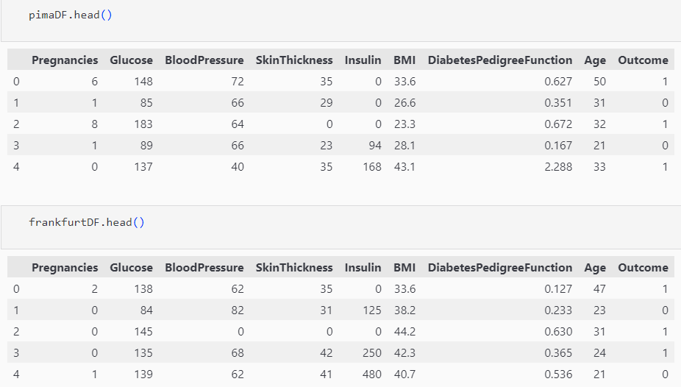
Dataset overviews - Columns
Both datasets consist of almost entirely numerical data split over 9 features, with the Pima Indian patient dataset containing 768 rows and the Frankfurt patient dataset containing 2000 rows, both with the following columns:
Pregnancies – The number of pregnancies the patient has had.
Glucose – Plasma glucose concentration over 2 hours in an oral glucose tolerance test.
BloodPressure – Diastolic blood pressure in mm/Hg.
SkinThickness – Triceps skin fold thickness (mm)
Insulin – 2-hour serum insulin
BMI – Body Mass Index, calculated from the patient’s weight and height.
DiabetesPedigreeFunction - The product of a function to ascertain the probability of diabetes based on family genetics. (Akmeşe, 2024)
Age – The patient’s age.
Outcome – Whether the patient is likely to develop diabetes.
Notes:
Outcome is the only categorical data here. You’ll notice there is no gender column, though the reason for that is described by the Pregnancies column – the dataset is entirely data on women.
Because they both use the same nine features and measure them the same way, we can therefore merge these two datasets into one.
The documentation of both datasets exclude the meaning of the pedigree function column. A review of literature using either of these two datasets reveals that it is the product of a function to ascertain the probability of diabetes based on family genetics. (Akmeşe, 2024)

Slide 4
Problem statement
Diabetes mellitus, or type 2 diabetes, accounts for 90% of the 4.4 million cases of diabetes in the UK, and it is estimated that there are 1.2 million undiagnosed cases of type 2 diabetes, which poses a classification problem.
Every week, diabetes results in approximately 184 amputations, 930 strokes, 600 heart attacks and 2,990 cases of heart failure. (Diabetes UK, 2023)
Through leveraging machine learning to classify individuals with or without type 2 diabetes, it will be possible to gain faster diagnoses and hopefully reduce the number of resultant casualties.
Notes:
The dataset poses a clear binary classification problem as evidenced by its Outcome column. Through using the other 8 features as predictors, it should be possible for a supervised learning model to predict the value of the Outcome column when the 8 predictors are supplied.

Slide 5
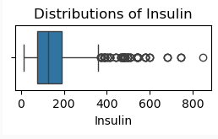
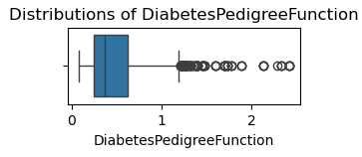
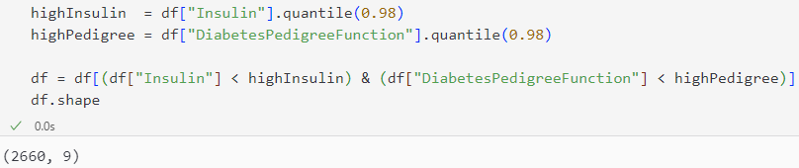
Distributions and outliers
The columns with a considerable amount of outliers are Insulin and DiabetesPedigreeFunction. Some of these outliers are on an extreme scale, which could affect the ML models. Therefore, rows over the 98th percentile for each of these columns were removed, which totals to 108 rows.
Notes:
The removal of data is typically a poor option. However, in this scenario where the data is wildly out of range, it is a valid option due to how heavily it can mislead certain ML algorithms.

Slide 6
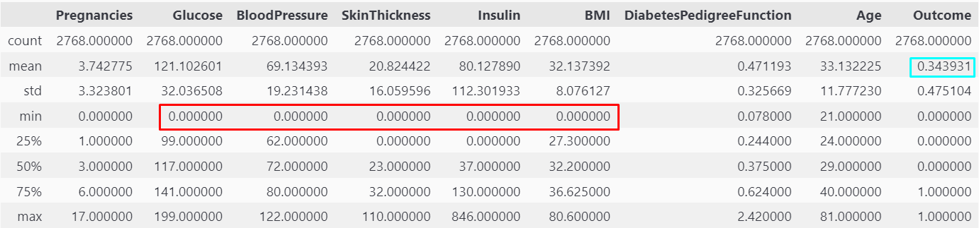
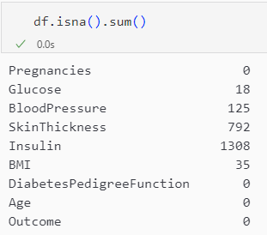
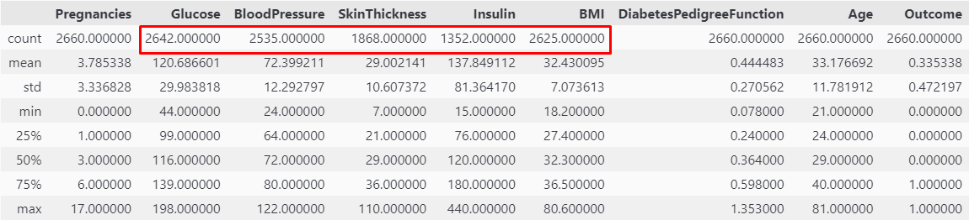
Missing data
Originally, it appeared as though there were no missing values in any columns. However, the overall dataset description revealed impossible values in some columns, which were substituted for N/A values.
After replacing the impossible 0 values with N/As, we receive a better reflection of missing data in the dataset, indicating that many values will require imputation.
Notes:
The discrepancies in question are the five red highlighted boxes, showing that there are rows where Glucose, BloodPressure, SkinThickness, Insulin or BMI are 0.
These are not physically possible unless this dataset includes the deceased, which it does not.
Additionally, we can see that the mean of our target variable is less than 0.5, meaning the dataset is imbalanced towards patients without diabetes, though this will be addressed in a later slide.

Slide 7
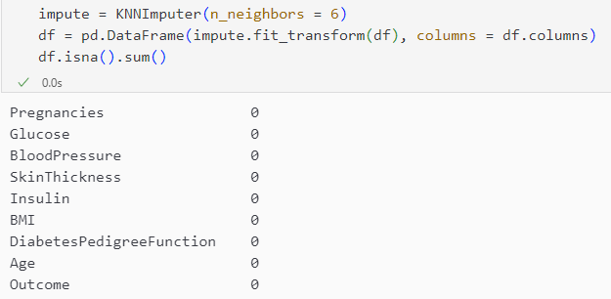
Handling missing data
We have established that these datasets contain a substantial amount of missing data. Addressing this can be solved in multiple ways, such as:
Mean/Median Imputation: Filling missing values with the mean or median of the column.
KNN Imputation: Filling missing values based on the values of similar rows.
Data removal: The erasure of rows with missing data.
Of these methods, KNN Imputation was used to ensure that the relationships between the variables are preserved, as they will all be important in the classification.
Notes:
Columns is given as an argument to pd.DataFrame because the KNNImputer returns a NumPy array, which means the column names would otherwise be lost and replaced by 0, 1, 2, 3, etc.
The neighbours used in the KNNImputer will be subject to change with hyperparameter tuning during development.
The number of neighbours will increase the computational power required, but might not necessarily yield better results, hence the need for iterative tuning.
Mean/Median: Doesn’t account for the relationships between variables, such as BMI and SkinThickness.
KNN: Does account for the relationships between variables but may be computationally expensive.
Removal: Only done where absolutely necessary, as it directly reduces the amount of data the model can train from and may cause misleading trends. Very bad for this database given the large amount of missing data

Slide 8
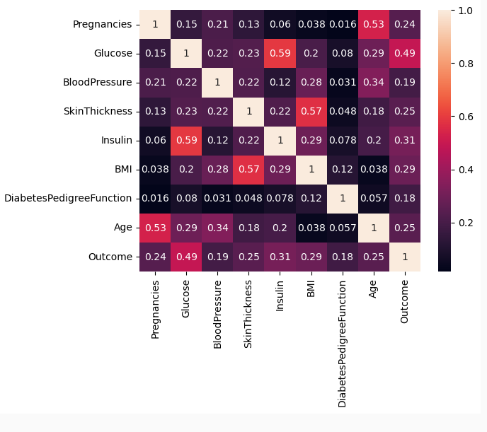
Data Correlations
The correlation heatmap reveals many expected trends within the data, such as:
Glucose is closely linked to the outcome.
Insulin is closely linked to the outcome.
Glucose is closely linked to Insulin.
BMI is closely linked to SkinThickness.
These correlations will have benefitted the previously used KNN Imputer, as it will have learned the strong relationships between these features.
However, there are some unexpected trends such as the diabetes pedigree function not being too heavily correlated with the outcome, which substantiates MedlinePlus (2017)’s claim that type 2 diabetes does not have a clear pattern of family inheritance.
Notes:
Left side is slightly cropped due to DiabetesPedigreeFunction being such a long column name.
Interestingly, the pedigree function has a low correlation with the outcome, though this is likely due to the fact that type 2 diabetes is not entirely a hereditary condition, and is more influenced by other factors such as weight, which is also reflected within the correlation matrix.

Slide 9
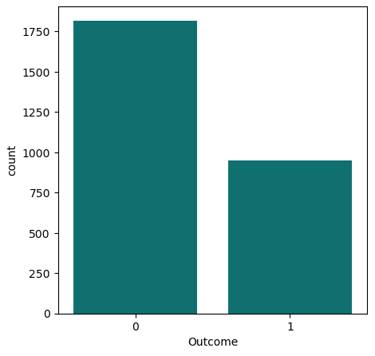
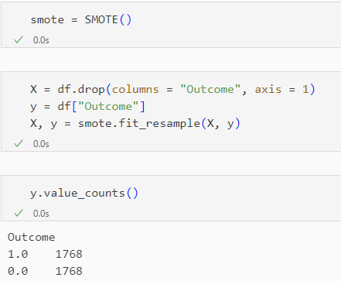
class imbalance
The dataset is highly imbalanced, with 1816 records without diabetes, and only 952 with diabetes. This would cause a machine learning model to be biased, favouring an outcome of 0, or no diabetes. This can be solved using the Synthetic Minority Oversampling Technique (SMOTE).
Notes:
As previously mentioned, this dataset is entirely numerical data other than its categorical target variable, meaning SMOTE has no issues parsing the existing data to generate new samples.

Slide 10
Model selection (1/2)
Multiple classification models will be used and compared on this dataset, including:
Support Vector Machine (SVM):
Identifies the best hyperplane (line of best fit) to split the classes. The distance between the hyperplane and the data points closest to it (support vectors) is known as the margin, and the size of the margin positively correlates with the quality of the SVM.
Random Forest:
Leverages multiple decision trees to learn trends in the data. Especially useful with numerical data like in this dataset.
Logistic Regression:
Calculates the probabilities of an instance belonging to a particular class through a logistic sigmoid function.

Slide 11
Model selection (2/2)
Naïve Bayes:
Calculates the probability of A (the target) given B (the other features). It assumes that all features are independent, which isn’t always true, especially in this dataset.
K-Nearest Neighbours:
Has already been used briefly to impute data. Calculates the average of the K closest data points, where K is the number of points specified.
These five models were chosen due to their frequent use across literature in binary classification tasks. Random Forest is frequently reputed to be one of the most accurate classification models, which this project can evaluate through comparison against others.

Slide 12
Evaluation metrics
The primary metrics used to evaluate the chosen models will be their accuracy and F1-Scores, as they are classification models.
Accuracy refers to the percentage of correct predictions (true positive, true negative) of the testing set.
F1-Score is the harmonic mean of the precision and recall of the model, as a high precision indicates a low false positive rate, and a high recall indicates a low false negative rate. The mean of both therefore provides a strong metric of the model’s performance.
Notes:
Precision is how many of the predicted positives actually were positive. (Predicted amount of positives divided by actual amount of positives).
Recall is how many of the actual positives were correctly predicted (Correctly guessed positives divided by number of positives in the entire dataset).
A confusion matrix provides a good visual representation of the model’s predictions.

Slide 13
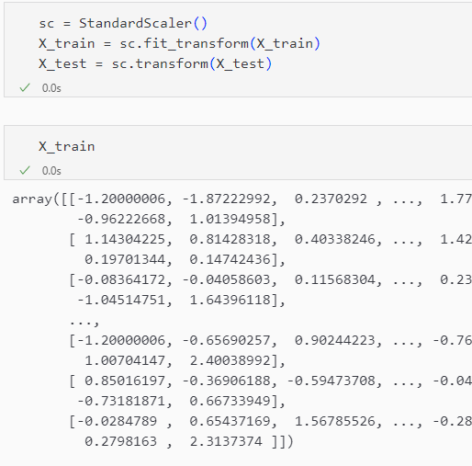
Train/test split and numeric scaling
The earlier use of SMOTE means that the dataset is now balanced, allowing for a randomised train/test split via Scikit-Learn to divide the data into training and testing sets at an 80:20% ratio.
Splitting the data like this allows the model to be evaluated, as there will be a labelled set of data to compare its predictions to.
After this, the numerical data will be standardised using a StandardScaler due to its high variance. This will be beneficial for models such as KNN and SVMs that can be skewed by large differences in data points.
Notes:
The random state argument to train_test_split sets a predetermined randomness seed for the random selection of rows to include in each set. This ensures that this same train/test split can be reproduced using the given seed, which is 42 here.

Slide 14
Potential Challenges
The dataset contained many missing values, which were solved via the KNN Imputer, though it is possible that this could reduce the performance of the model.
01
The dataset was heavily imbalanced towards people without diabetes, which was addressed via SMOTE.
02
It is possible that the combination of KNN Imputer and SMOTE has converted the dataset largely into synthetic data. However, this data would still be useful in the analysis and diagnosis of diabetes.
03
From the correlation matrix, it can be determined that all of the dataset’s features are valuable to its analysis and should all be used as predictor variables in the model.
04
Notes:
This dataset didn’t have any categorical variables other than the target, though that was already numeric. Therefore, no encoding was necessary.

Slide 15
Conclusions
The exploration of the diabetes datasets have provided valuable insights into the factors associated with diabetes risk and prevalence. Through this analysis, the correlations between various physical attributes and diabetes have been revealed, and challenges with the wrangled datasets such as missing values and class imbalance were addressed.
01
The processes shown in this presentation, such as splitting the data and evaluating different classification algorithms, can now be further continued to yield supervised learning models for the binary classification of type 2 diabetes within the upcoming report, which will act as a roadmap detailing development of the models from start to finish including data exploration, modelling and evaluation.
02
It is possible that this project could have been further improved with higher quality datasets that contained more diverse data, as the models produced in this project will only be useful in the classification of female patients.
03
Notes:
From the analyses performed within this presentation and the more extensive and detailed EDA as part of the upcoming report, it should be possible to train and evaluate ML models based on five different algorithms. They can then be compared and contrasted in terms of their evaluation metrics to determine the best option for the binary classification of diabetes in women.

Slide 16
References
Diabetes UK (2023) How many people in the UK have diabetes? Available at: https://www.diabetes.org.uk/about-us/about-the-charity/our-strategy/statistics (Accessed: 25 November 2024).
Zou, Q., Zhang, Y. and Chen, C.S. (2024) ‘Construction and Application of a Machine Learning Prediction Model Based on Unbalanced Diabetes Data Fusion’, in Proceedings of the 2023 International Joint Conference on Robotics and Artificial Intelligence. New York, NY, USA: Association for Computing Machinery (JCRAI ’23), pp. 114–123. Available at: https://doi.org/10.1145/3632971.3633348.
Akmeşe, Ö.F. (2022) ‘Diagnosing Diabetes with Machine Learning Techiques’, Hittite Journal of Science and Engineering, 9(1), pp. 9–18. Available at: https://doi.org/10.17350/HJSE19030000250.
Chang, V. et al. (2023) ‘Pima Indians diabetes mellitus classification based on machine learning (ML) algorithms’, Neural Computing and Applications, 35(22), pp. 16157–16173. Available at: https://doi.org/10.1007/s00521-022-07049-z.
Czakon, J. (2022) 20 Evaluation Metrics for Binary Classification. Available at: https://neptune.ai/blog/evaluation-metrics-binary-classification (Accessed: 28 November 2024).
MedlinePlus (2017) Type 2 diabetes: MedlinePlus Genetics. Available at: https://medlineplus.gov/genetics/condition/type-2-diabetes/ (Accessed: 28 November 2024).
Datasets:
John DaSilva (2017) Frankfurt Diabetes Dataset. Available at: https://www.kaggle.com/datasets/johndasilva/diabetes (Accessed: 25 November 2024). UCI Machine Learning (2016) Pima Indians Diabetes Database. Available at: https://www.kaggle.com/datasets/uciml/pima-indians-diabetes-database (Accessed: 25 November 2024).
Notes:
These are the sources referenced directly or implicitly within the presentation. The Pima Indian dataset especially is backed by large amounts of literature which, while not directly referenced in this presentation, were consulted to gain an understanding of best practices.

